Slide 1

Why do we need this European declaration ?
We need this declaration because only together we can look towards future. We must understand that only having the same goals, cooperating we can solve future problems. We need active young people at the local, regional and European level. And this young people must get involved in debates and stimulate real debates.
Objectives:
-To stimulate young people to be as active as possible and to help them to make themselves as much as possible listened and not just “heard”;
-To promote democracy, to fight against poverty;
-To promote tolerance.

Slide 2
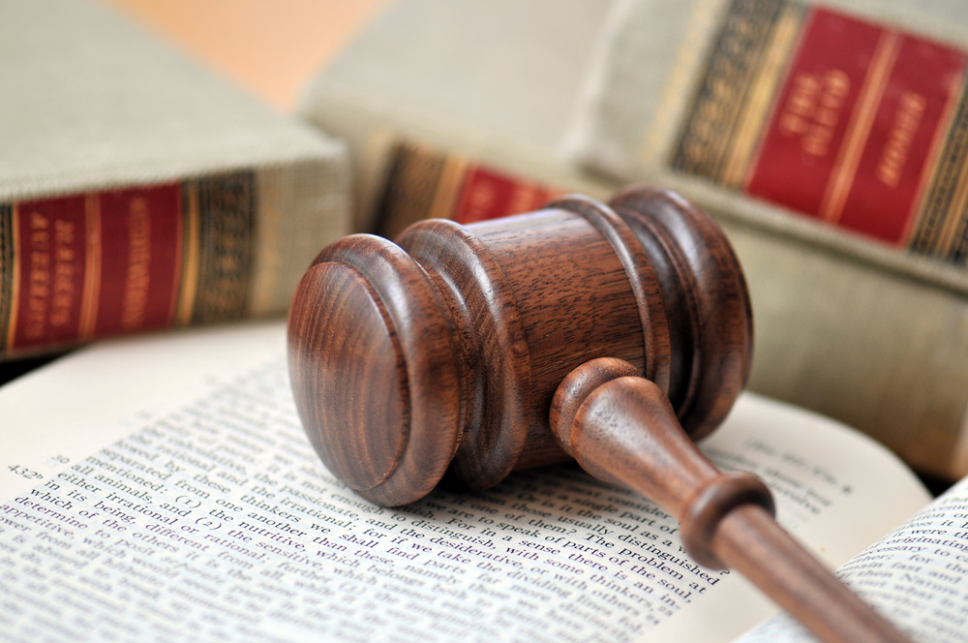
How shall Europe be governed?
The latest European events showed us how vulnerable Europe is and how hard it is to take decisions. The respect of law and democracy are essential. We think that the Treaty of Lisbon is a good model.

Slide 3
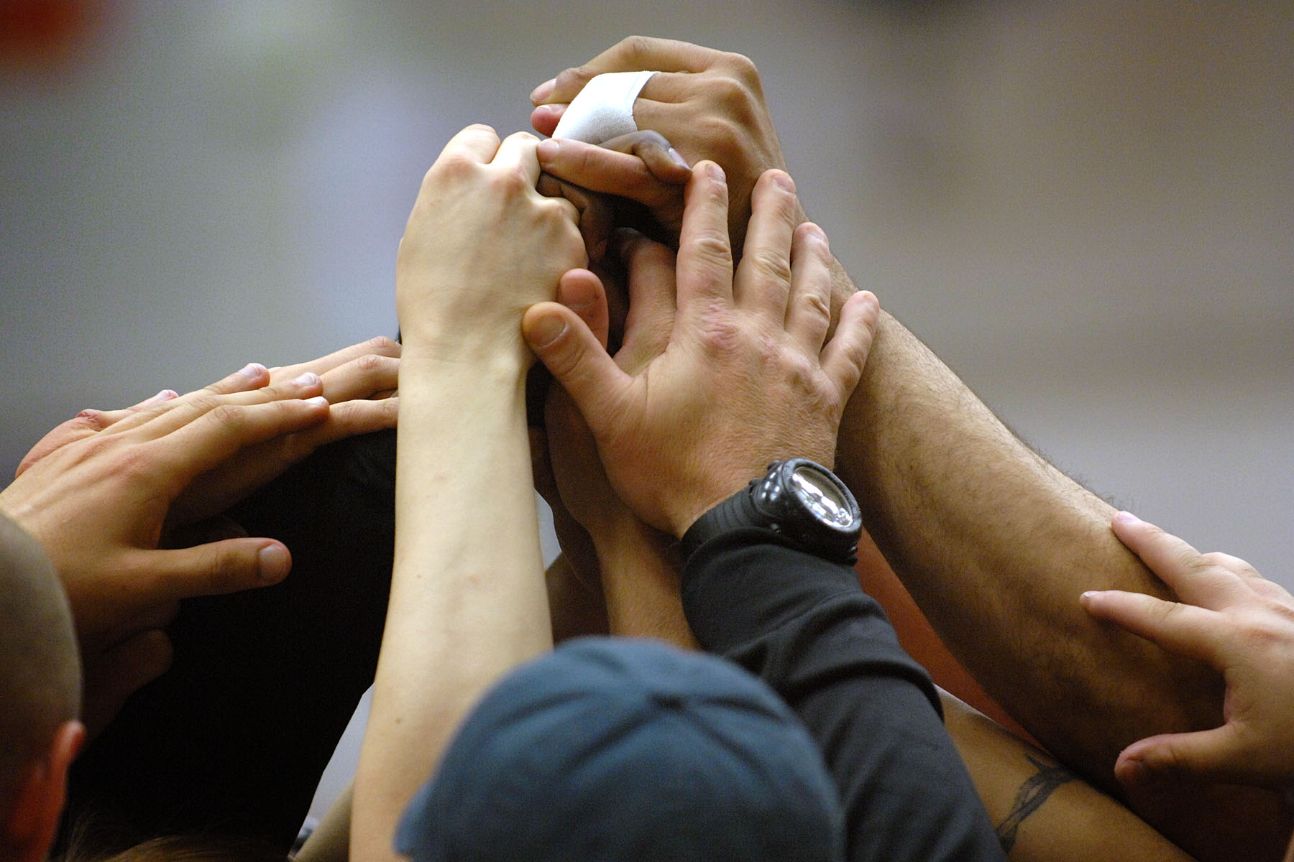
How much should Europe enlarge?
We do not think that there are limits. It was proved that with each member, EU has become more powerful and more stable. No state from our continent can be sure that in future can face alone the global challenges. Together we can be more powerful.

Slide 4
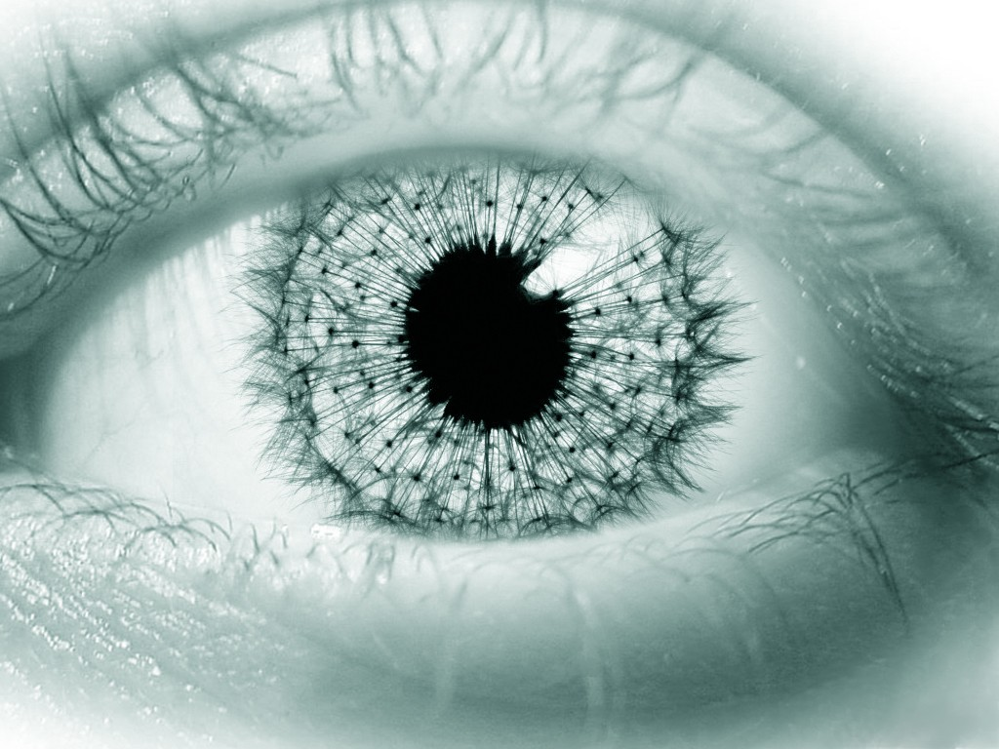
The rights and duties of the young Europeans.
Young people are important not just for the present moment but also for the future , a future which they can change in a positive way.
Rights:
-the right of self development;
-the right to have a name and a nationality, free access to information which concerns them;
-the right to education, culture;
-the rights regarding social care and health care;
-protection for the refugee children.
Duties:
There are two types of duties:
-written ones which come form the EU’s treaties and Committee’s directives .
And also the moral ones such as:
-the duty of getting yourself informed, participation to elections and vote.

Slide 5
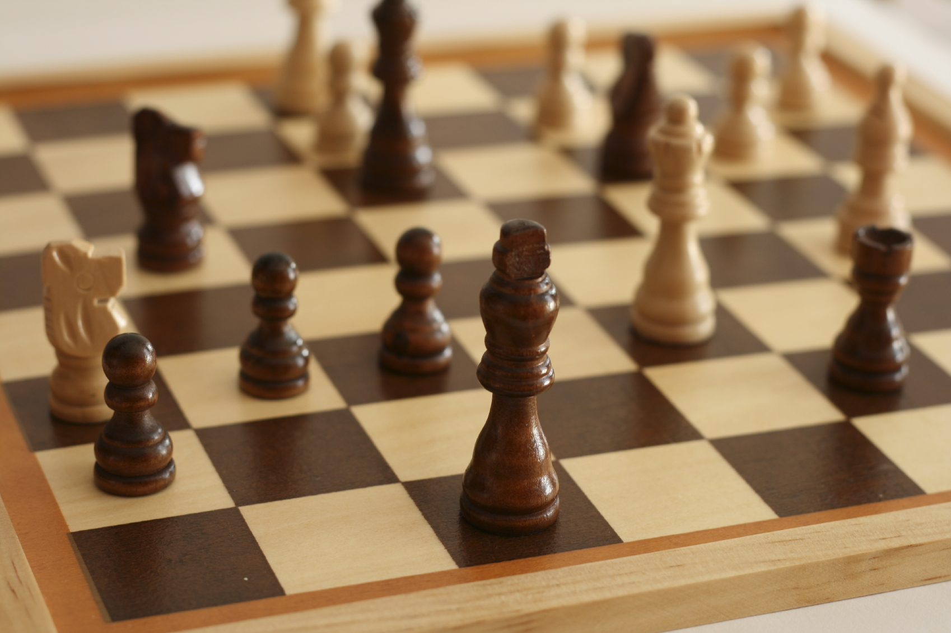
Advantages and disadvantages of being an EU member.
Advantages:
-Security ( economic, strategic of the resources );
-obtain a higher standard of civilization;
-free access to goods;
-the possibility to use the European funds.
Disadvantages:
We can not talk in a strong way about such thing. Romania, as all the other member states , has accepted the duties by signing the Treaty of Adherence and by participating in the decisional process. By entering the big European family you are aware that there are a range of rules and deadlines which must be respected and they can not be considered disadvantages.

Slide 6
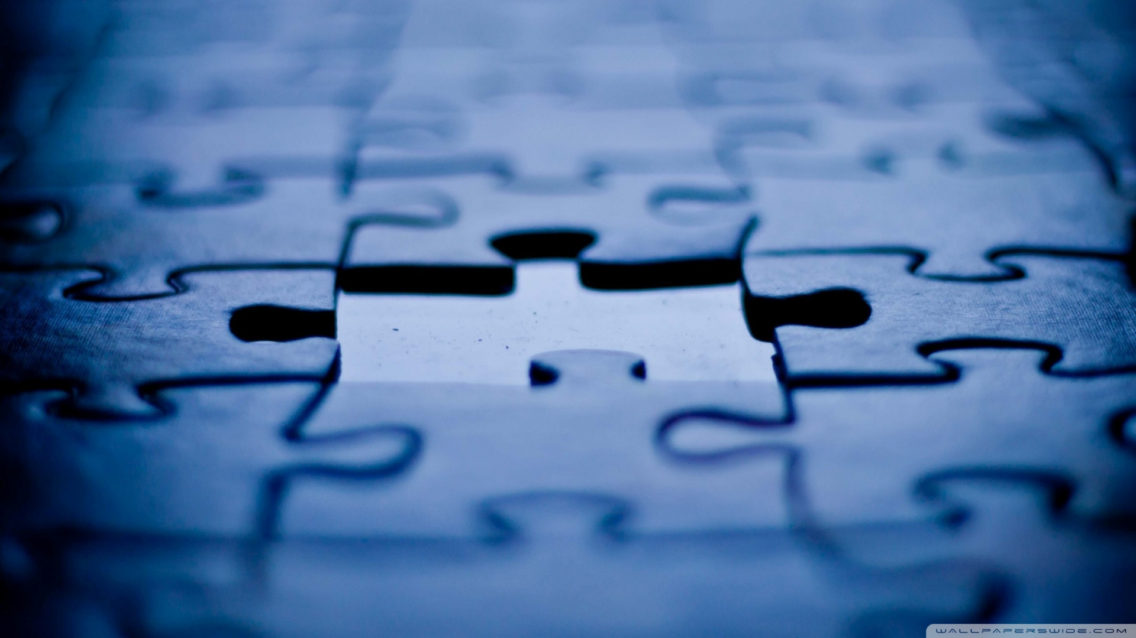
European Constitution ( what chapters must have? What should they stipulate? )
Its structure should have 5 big chapters:
Chaper I
European Union – European institutions and values.
Chaper II
The fundamental rights of the European Union citizens.
Chaper III
European Union Competences.
Chaper IV
European Union Finances.
Chapter V
Revise Possibilities ( improvements, adjustments in concordance with the possible changes which may happen in future ).

