Slide 1

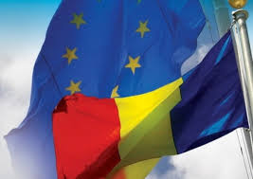
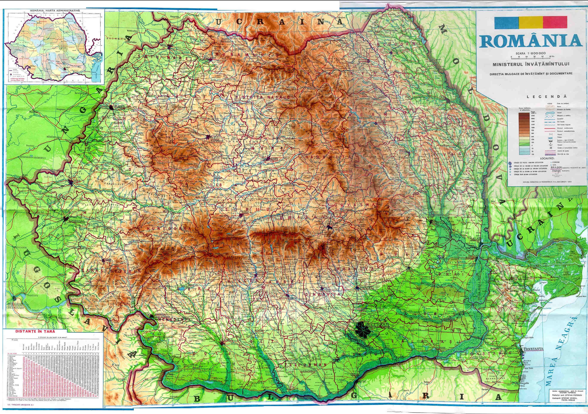
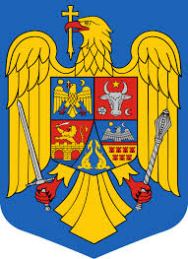
ROMANIA

Slide 2

Romania is a country located at the intersection of Central and Southeastern Europe, bordering on the Black Sea. Romania shares a border with Hungary and Serbia to the west, Ukraine and Moldova to the northeast and east, and Bulgaria to the south.
Etymology
Romania derives from the Latin romanus, meaning "citizen of Rome".
Language
The official language of Romania is Romanian, a Latin language related to Italian, French, Catalan, Spanish and Portuguese.

Slide 3
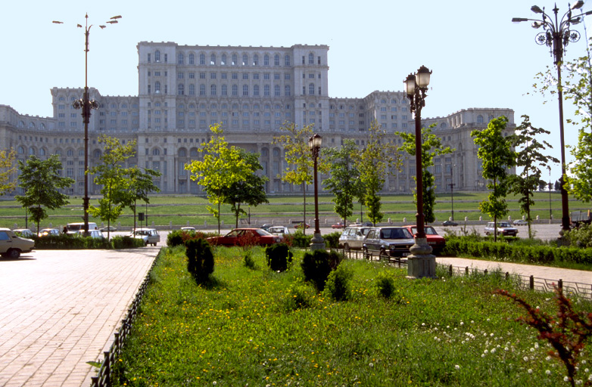
BUCHAREST, THE CAPITAL CITY
Government
Romania is a semi-presidential republic where executive functions are held by both government and the president. The president is elected by popular vote for a maximum of two terms, and since the amendments in 2003, each term lasts five years .
The Parliament Palace

Slide 4
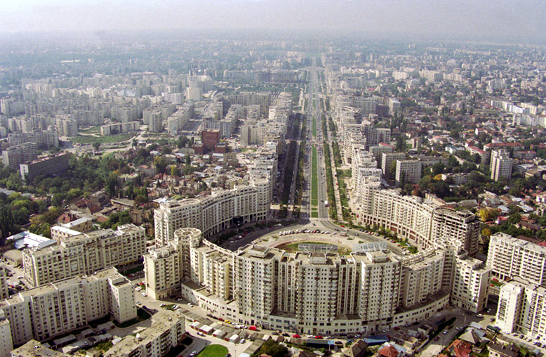
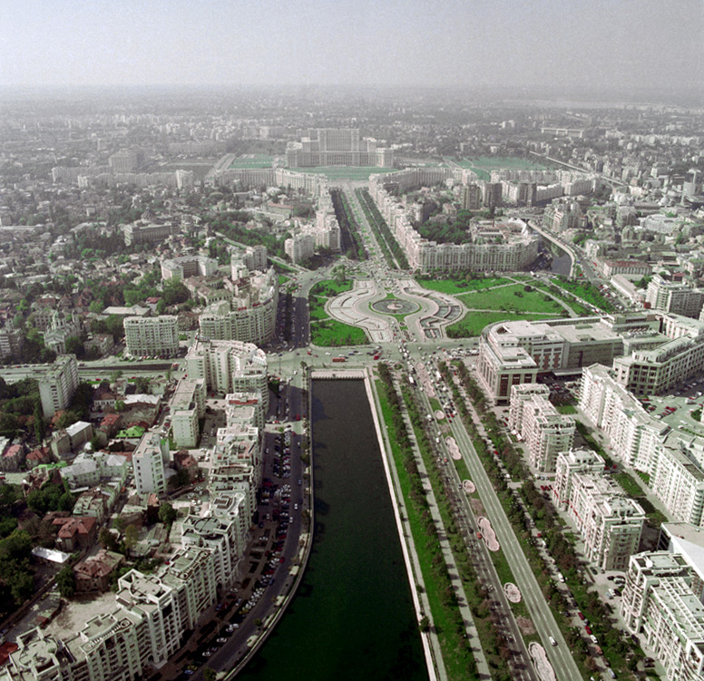
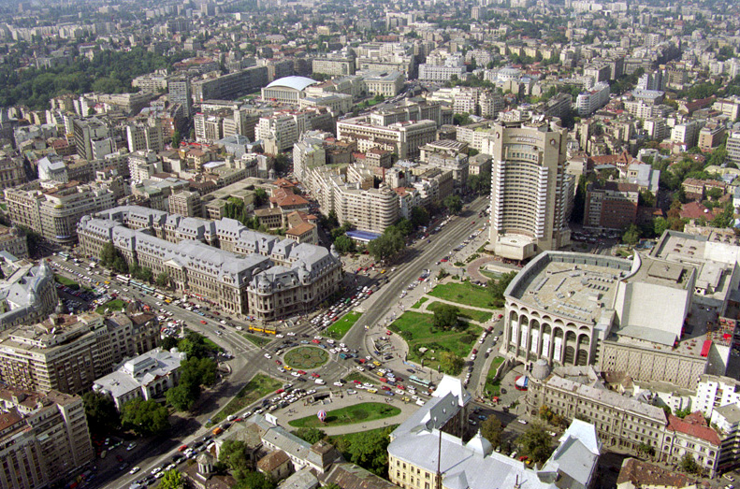
Romania is the eighth largest country of the European Union by area, and has the seventh largest population of the European Union.
Its capital and largest city is Bucharest – the sixth largest city in the EU.

Slide 5
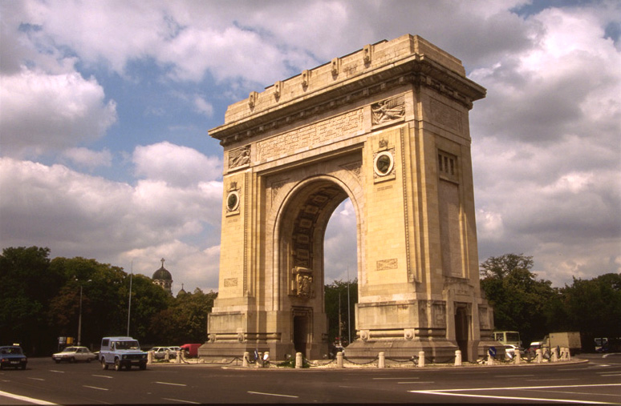
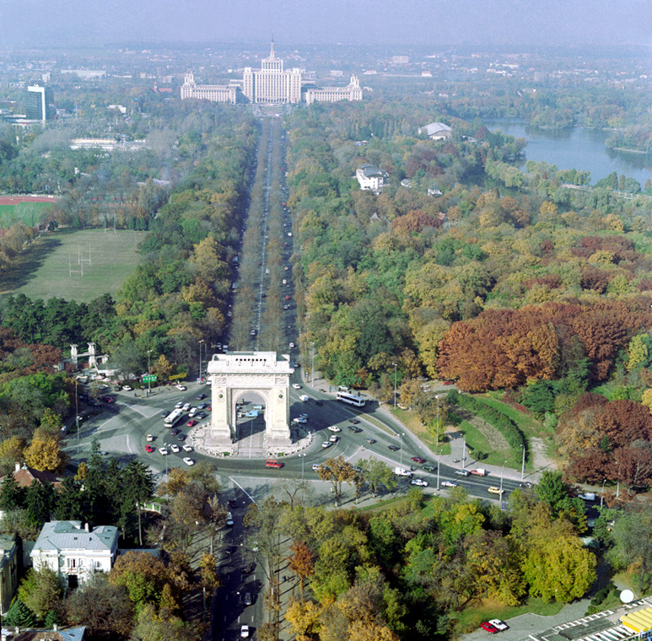
The Triumphal Arch located in the northern part of Bucharest, on the Kiseleff Road.
The current arch has a height of 27 metres and was built after the plans of the architect Petre Antonescu.
The sculptures with which the facades are decorated were created by famous Romanian sculptors such as Ion Jalea and Dimitrie Paciurea.

Slide 6
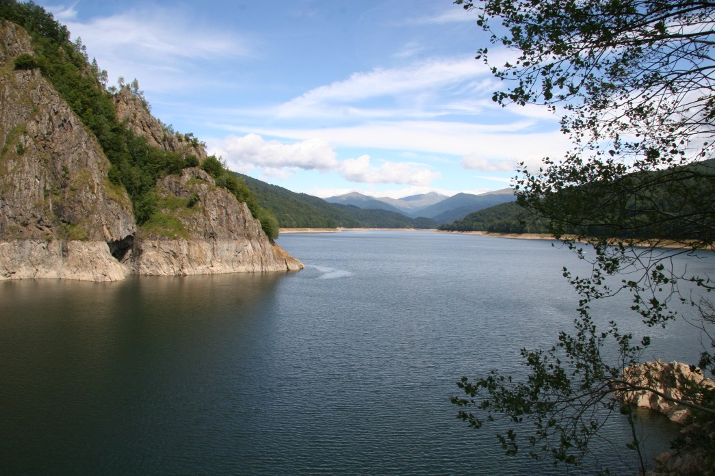
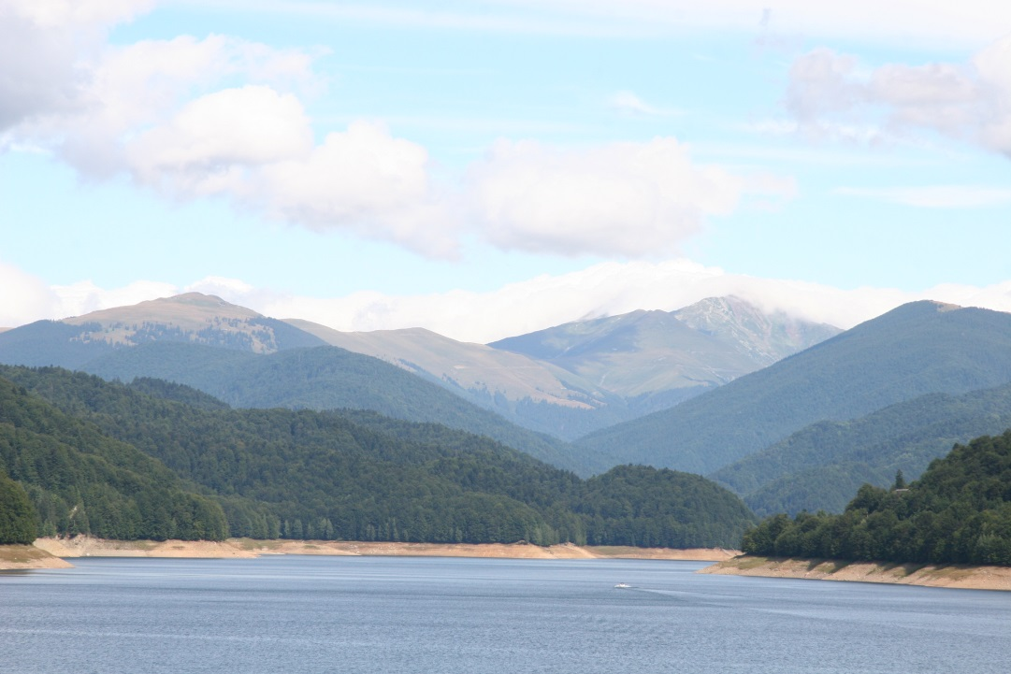
THE CARPATHIANS
The Carpathians consist of a chain of mountain ranges that stretch in an arc from the Czech Republic (3%) in the northwest through Slovakia (17%), Poland (10%), Hungary (4%) and Ukraine (11%) to Romania (53%) in the east and on to the Iron Gates on the River Danube between Romania and Serbia (2%) in the south.
The Carpathians and their piedmont also concentrate many thermal and mineral waters, with Romania having over one-third of the European total.

Slide 7
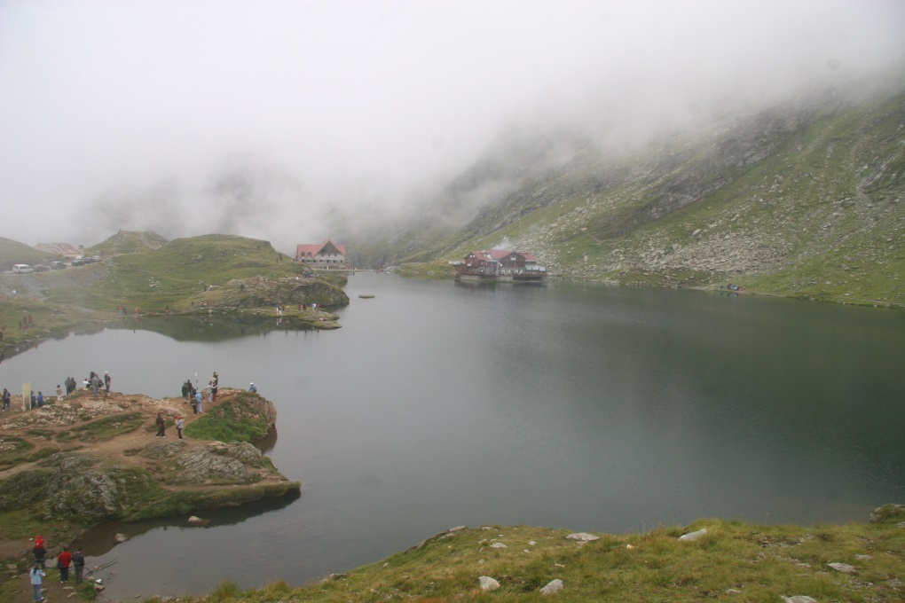
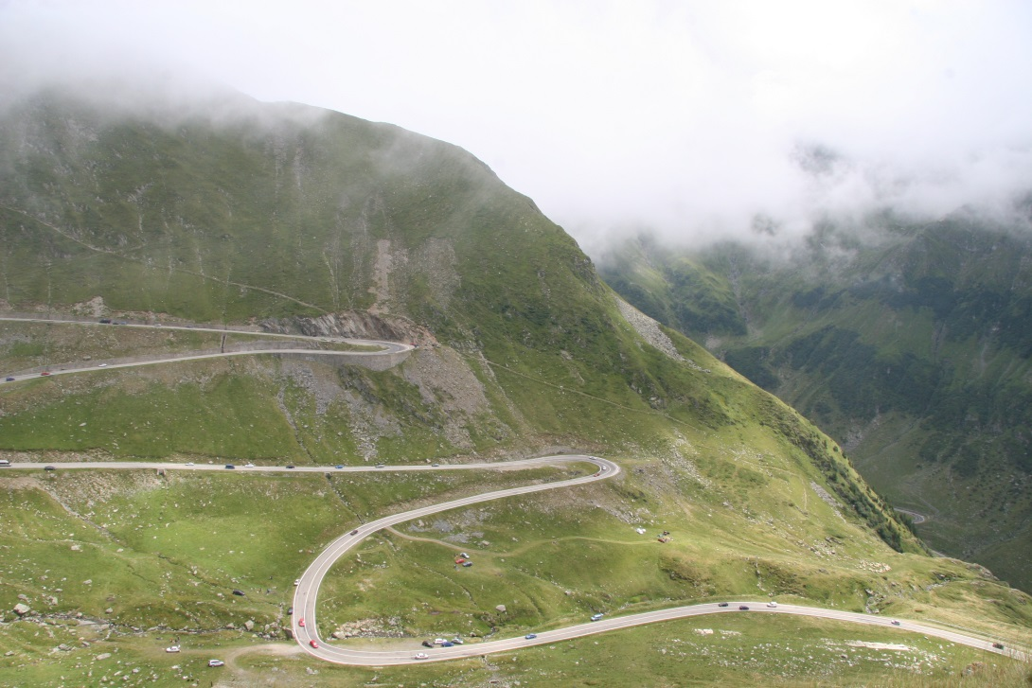
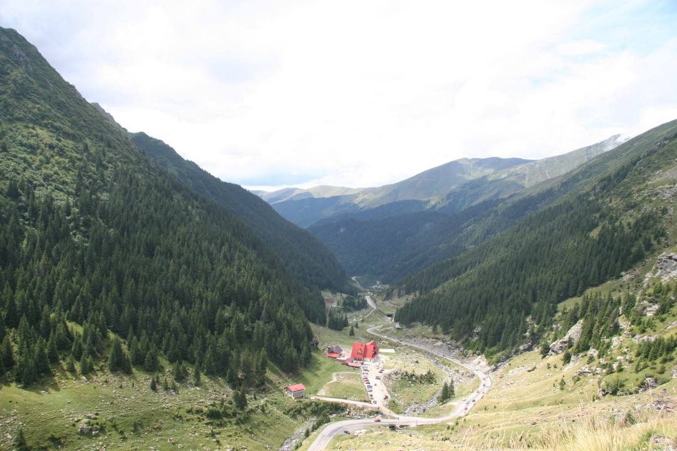
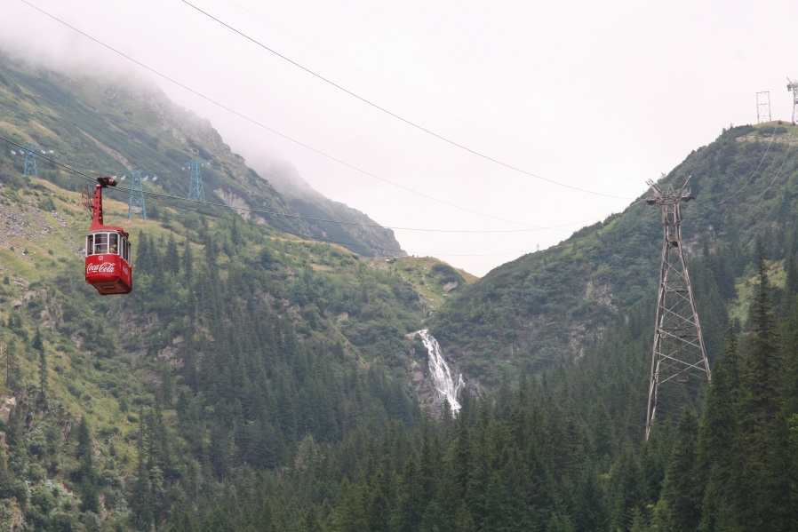

Slide 8
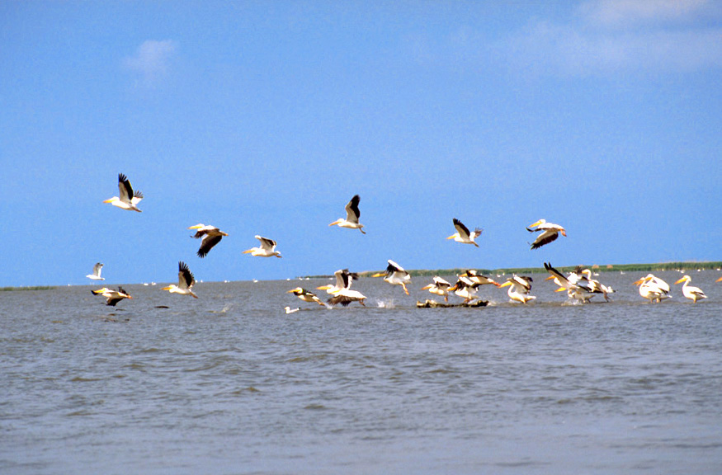
THE DANUBE DELTA

Slide 9
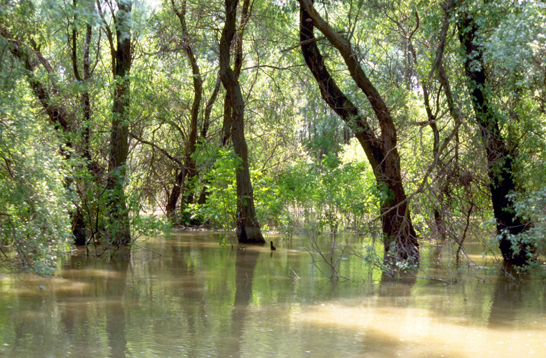
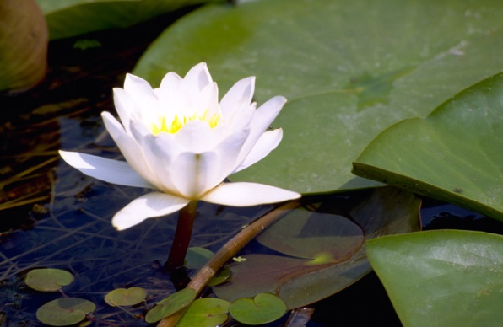
The Danube Delta is the second largest river delta in Europe, after the Volga Delta.
The approximate surface is 4,152 km², of which 3,446 km² are in Romania.

Slide 10
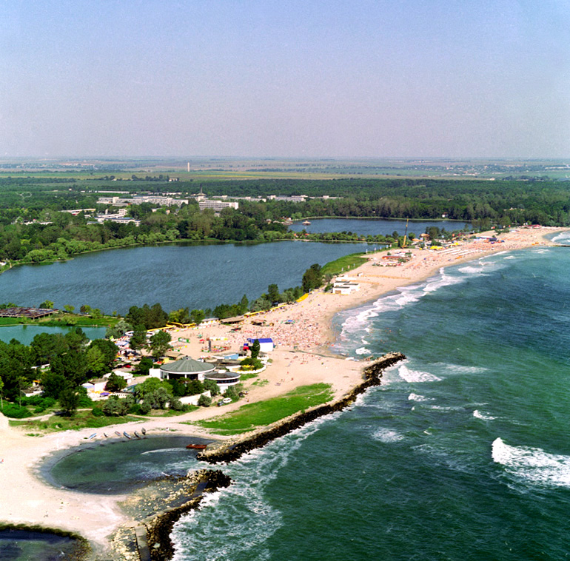
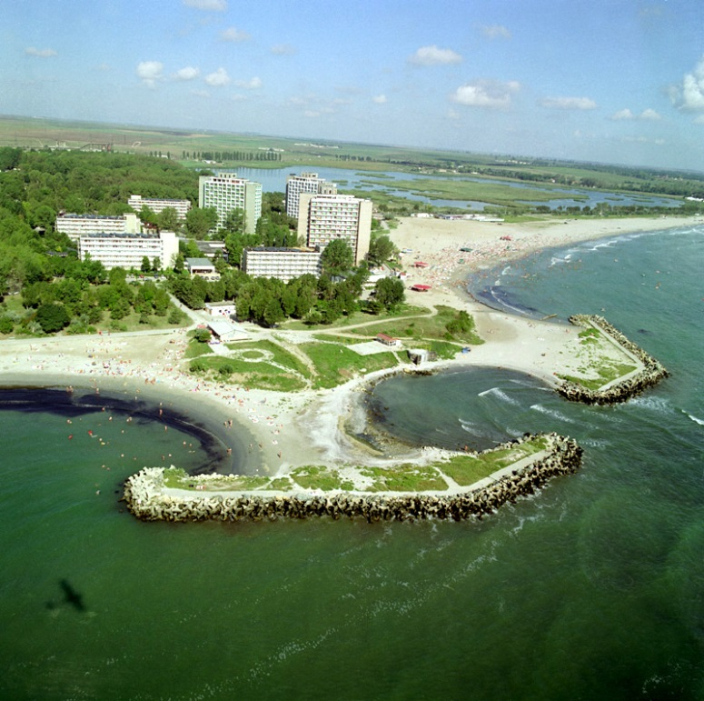
THE BLACK SEA COAST
It is bounded by Europe, Anatolia and the Caucasus and is ultimately connected to the Atlantic Ocean via the Mediterranean and the Aegean Seas and various straits.
Mediterranean water flows into the Black Sea as part of a two-way hydrological exchange.

Slide 11
The Romanian educational system consists of four levels of studies. These levels are kindergarten, primary, secondary and higher education. As per the educational guidelines as set forth by the Ministry of Education and Research, kindergarten is optional for children aged three to six. Primary school begins when the child age is six or seven. This level of education is obligatory until the tenth grade. The next phase is higher education and is also an optional phase of education.
Kindergarten
The kindergarten level is an optional one and is available for children as young as three years old until they reach six or seven years old.
Elementary or Primary School
Public schools offer free education, but textbooks and some school materials like pencils, notebooks and uniforms may need to be separately purchased.

Slide 12
School Year
The school year begins on the month of September and ends in June of the following year. The school year is divided into two semesters, the first one from September to January and the second one from February to June.
Grading Systems – Lower Levels
The first four years of elementary school follows a system called the calificative. There are four grades. Foarte Bine or FB corresponds to Excellent, Bine or B for Good. Satisfacator/Suficient or S for Satisfactory (which connotes a barely passing grade) and Nesatisfăcător/Insuficient or I for failed marks.
Grading Systems – Upper Levels
A different grading system is used for upper elementary levels. Grades 5 to 12 use a 1 to 10 grading system, with one being the lowest grade and 10 being the highest.
High Schools
After the 8th grade, students are required to take the Testarea Naţională or the National Test. This is a nationwide examination that can only be taken once. The subjects included in the test are Romanian Language and Literature and Maths.

Slide 13
SLATINA
Slatina is the capital city of Olt County, on the river Olt. The city administers one village, Cireaşov. The town of Slatina was first mentioned on January 20, 1368 .
Alro Slatina, the largest aluminum producing factories in Southeastern Europe, is located in the city. Other companies based in Slatina include ALPROM (which, like ALRO, is a subsidiary of VIMETCOGROUP), Altur (engine set manufacturer), Pirelli Tires Romania (tire-manufacturer), Cord Romania (steel cord for tires), TMK Artrom (seamless steel tubes), Prysmian (electronic and electric wires and cables).

Slide 14
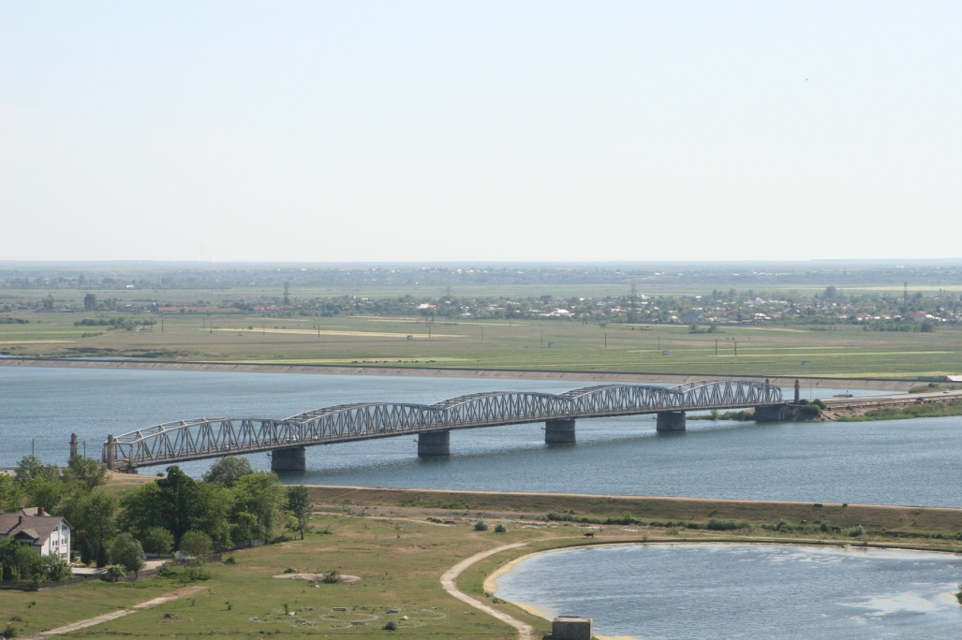
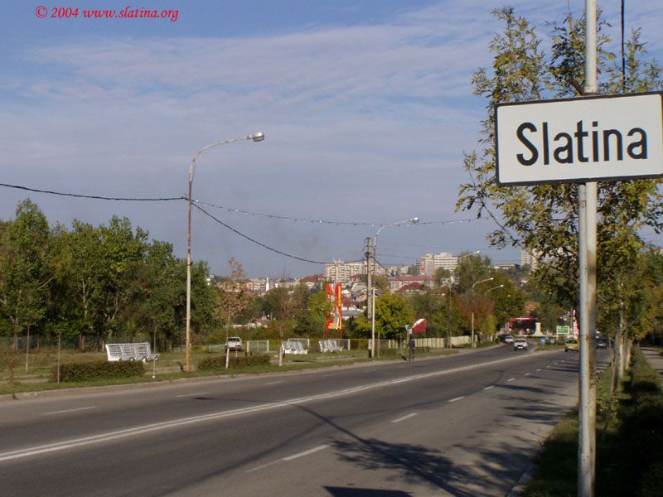
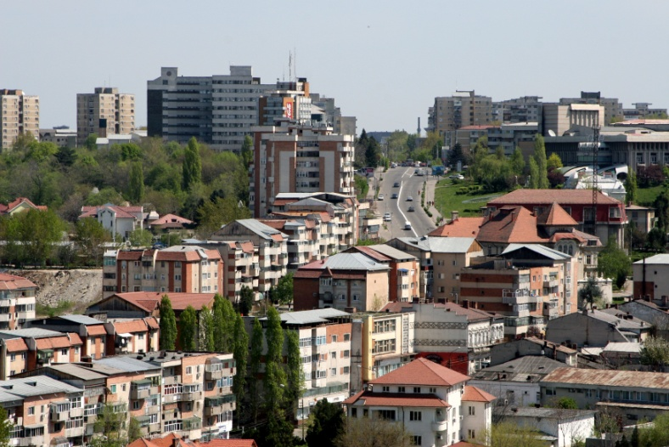
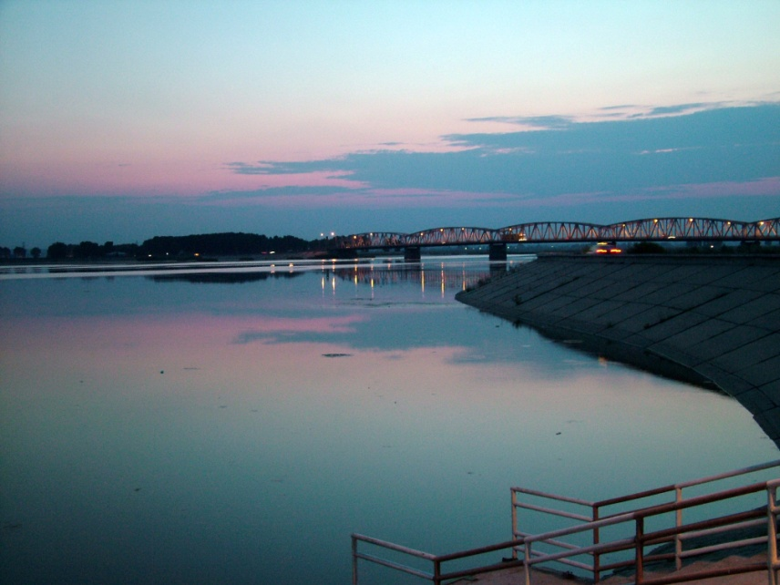

Slide 15
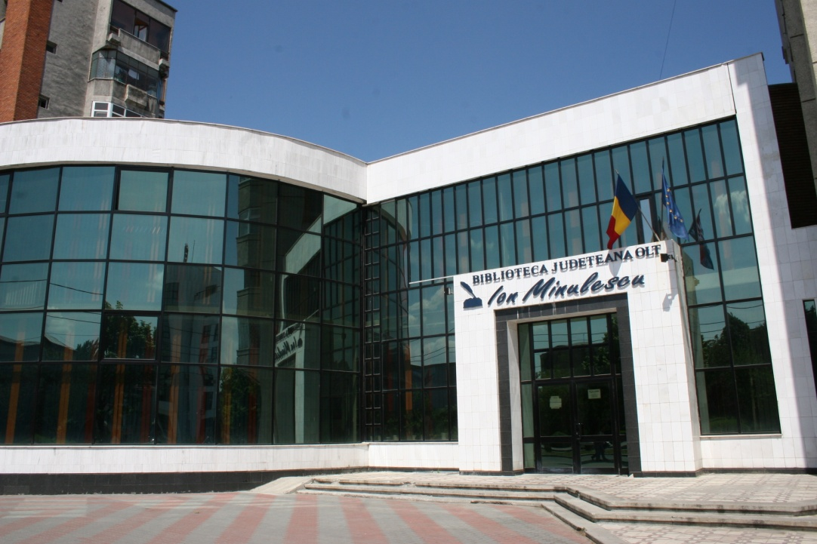
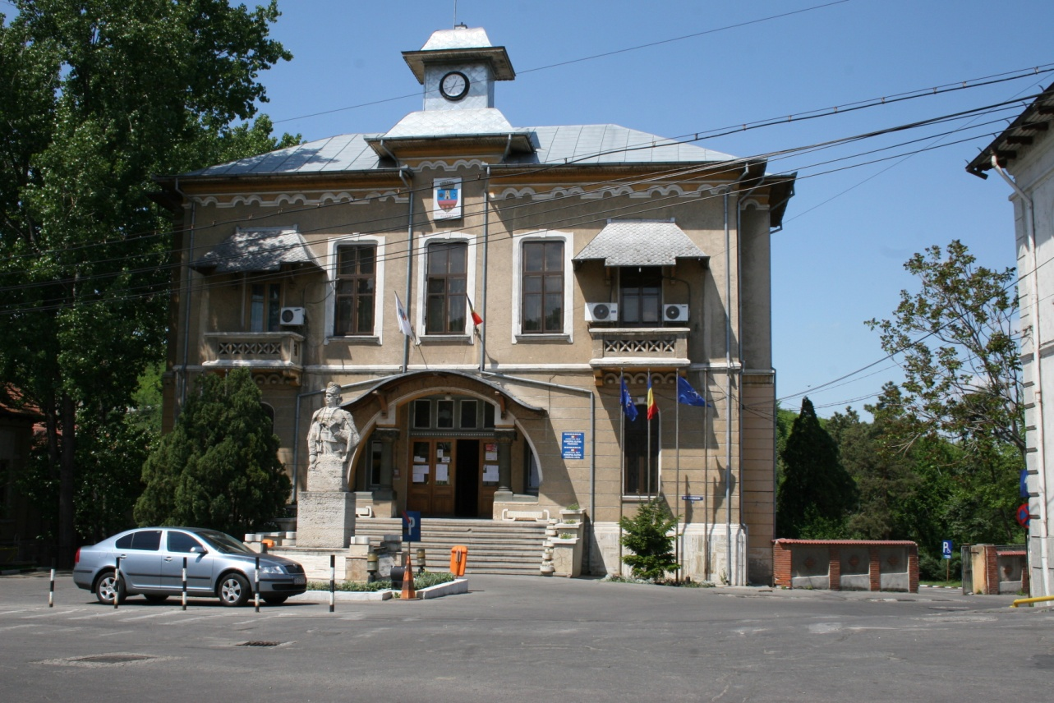
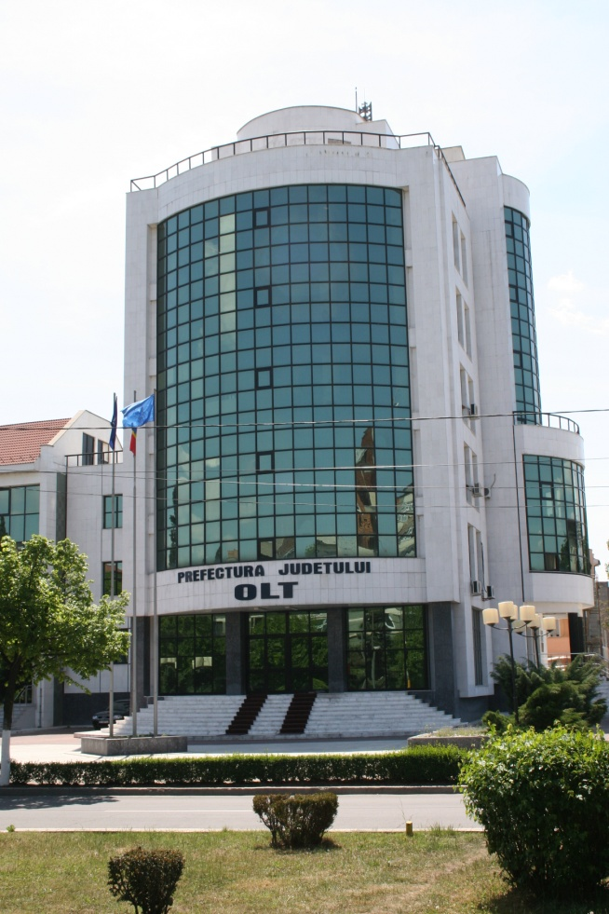
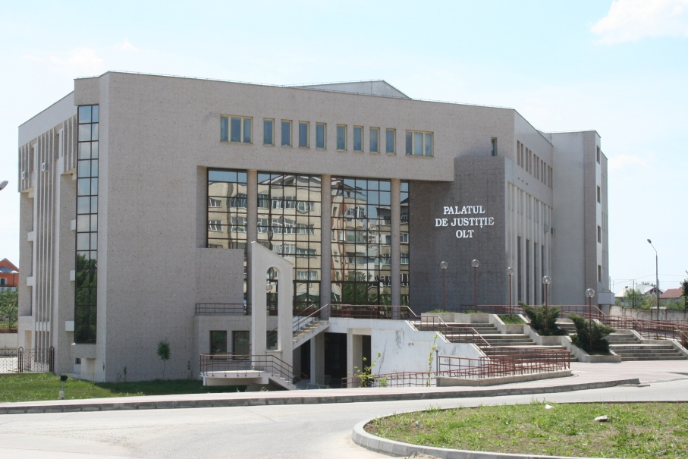

Slide 16
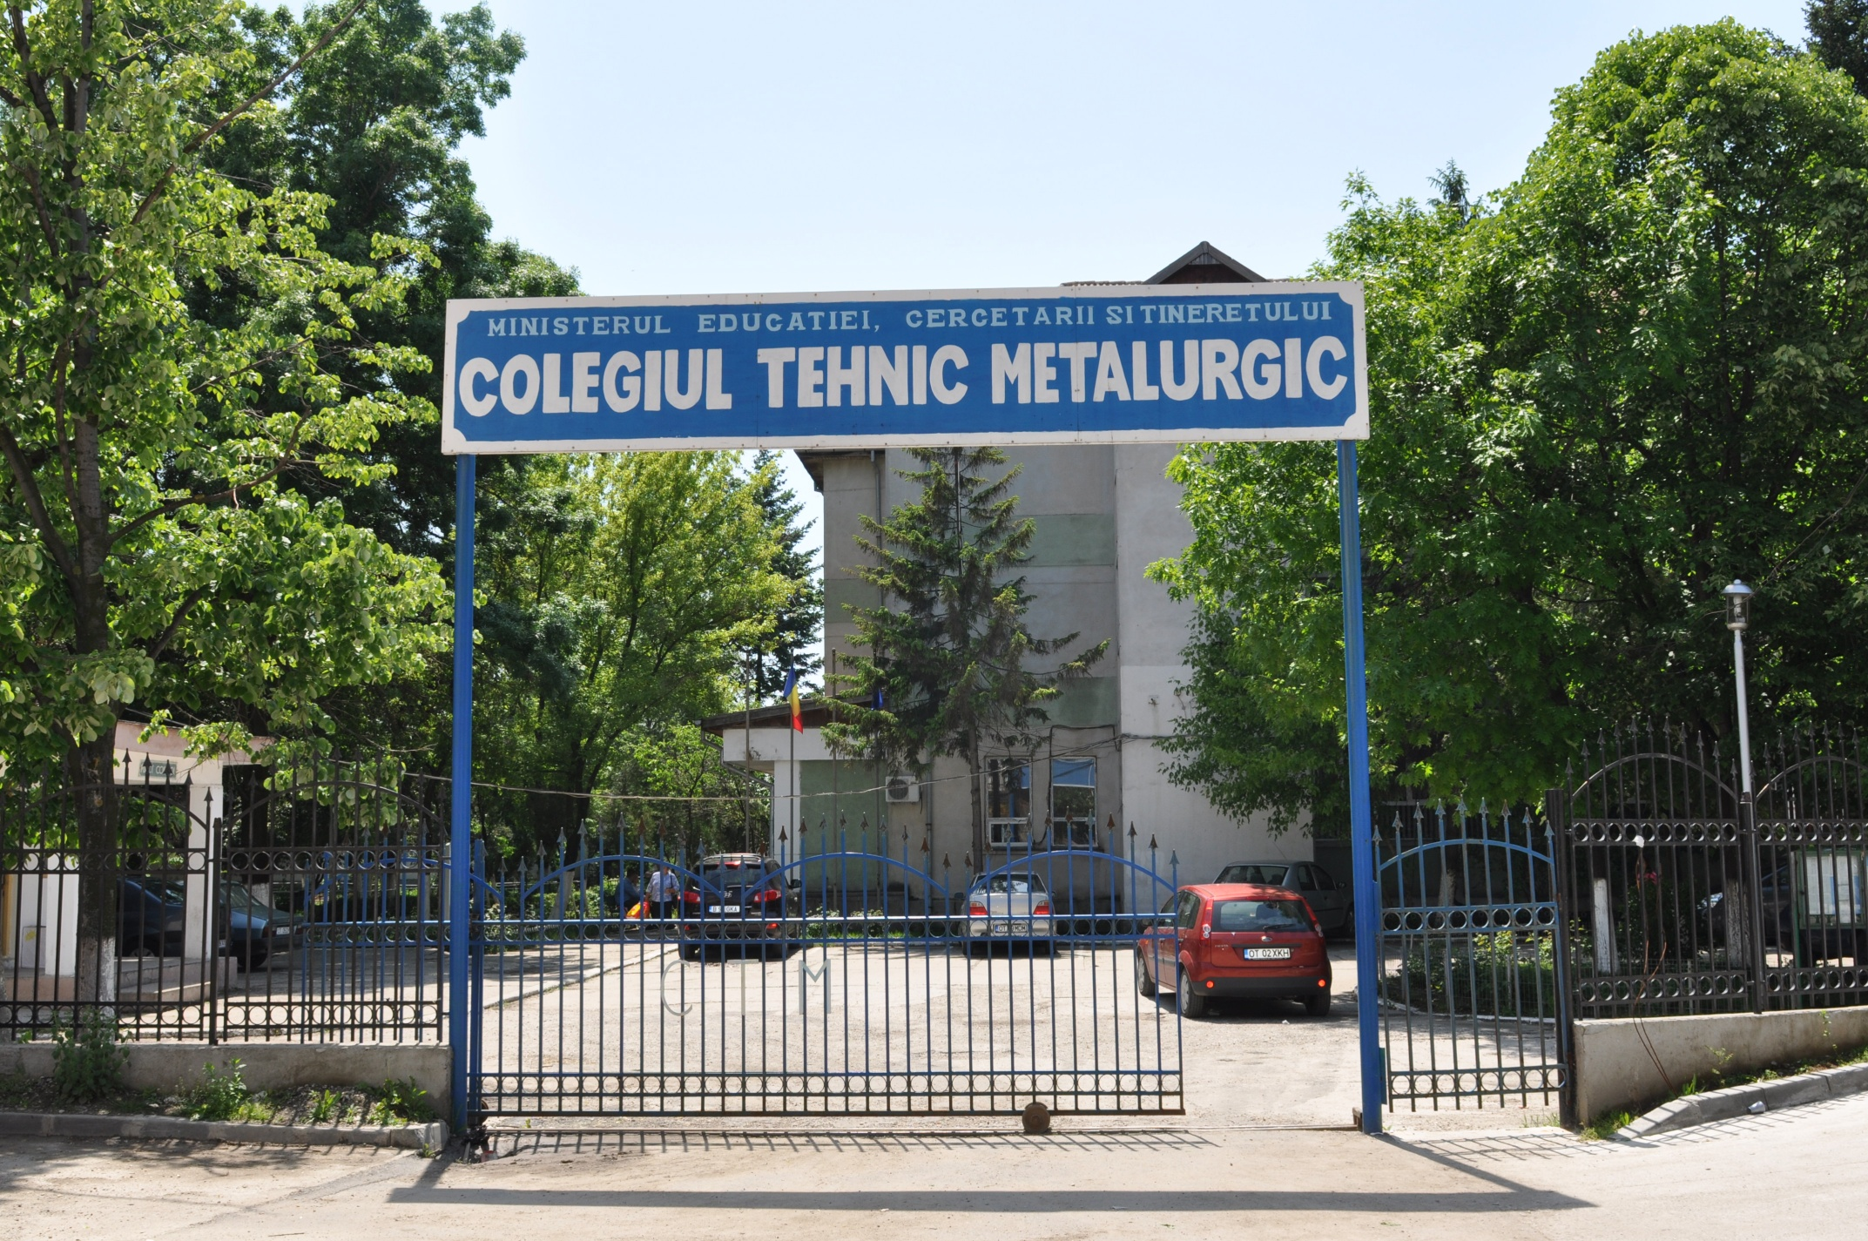
METALURGIC TECHNICAL HIGH SCHOOL
Number of students: 1243
Number of teachers: 66
Fields of education:
- Industrial Chemistry
Protection of environment
Mechanics
Electronics
Transport
Our school has partnerships with local agents mentioned on the previous slide as for students to practice their skills.
Endowment:
Library
School canteen
School hostel
9 Labs
Gym

Slide 17
THANK YOU FOR YOUR TIME!

